Slide 1
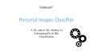
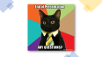
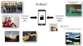
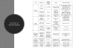
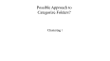
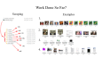
PIC: Personal Images Classifier
By: Ashraf Adel - 196280
Supervised By:
Associate Prof. Nahla Barakat
Questions
Problem Statement
PIC
Summary of Possible Models
Proposed Solution
Pre-processing the Dataset
Current Work Done

Slide 2
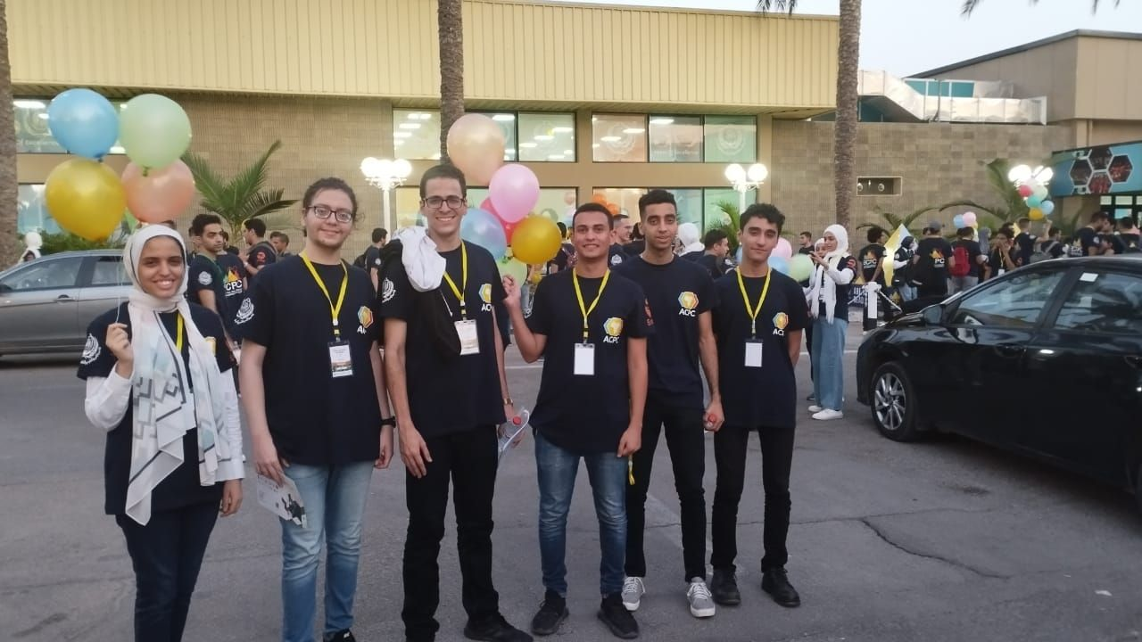


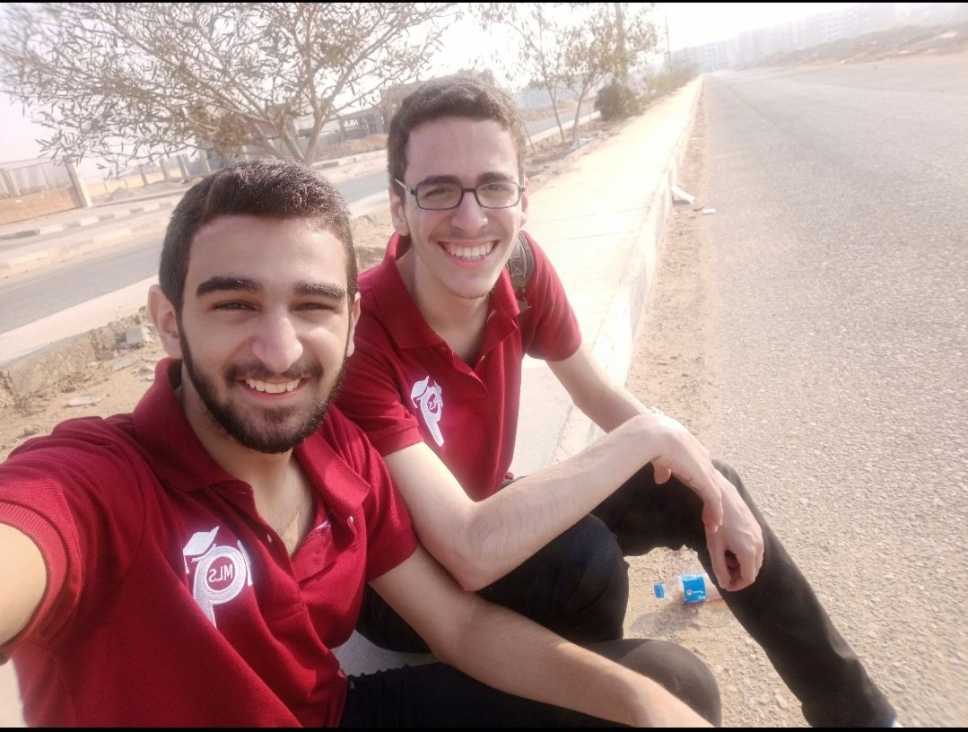



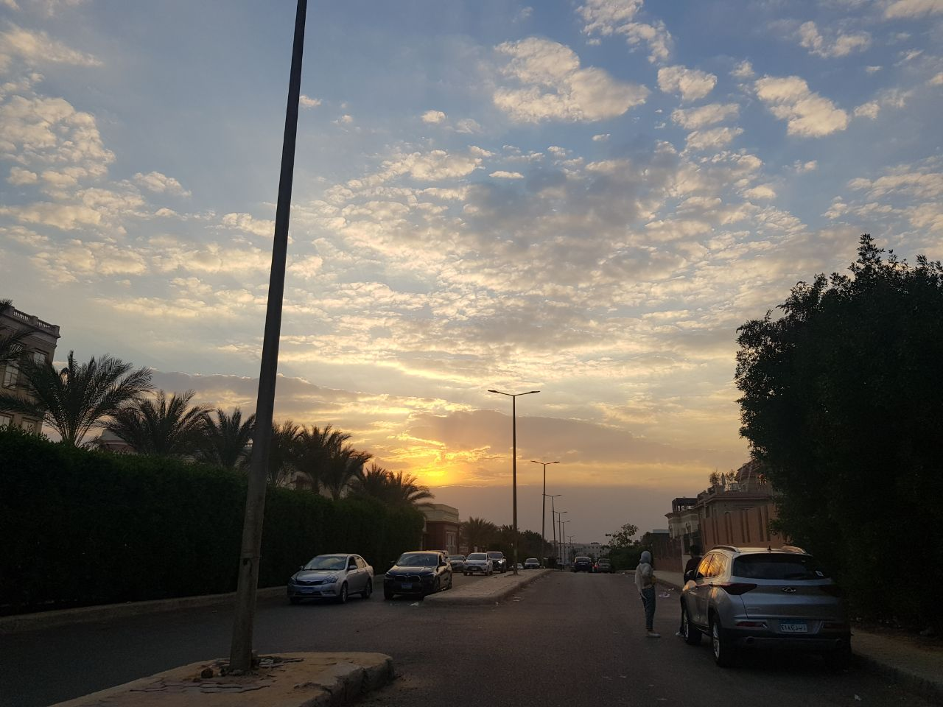
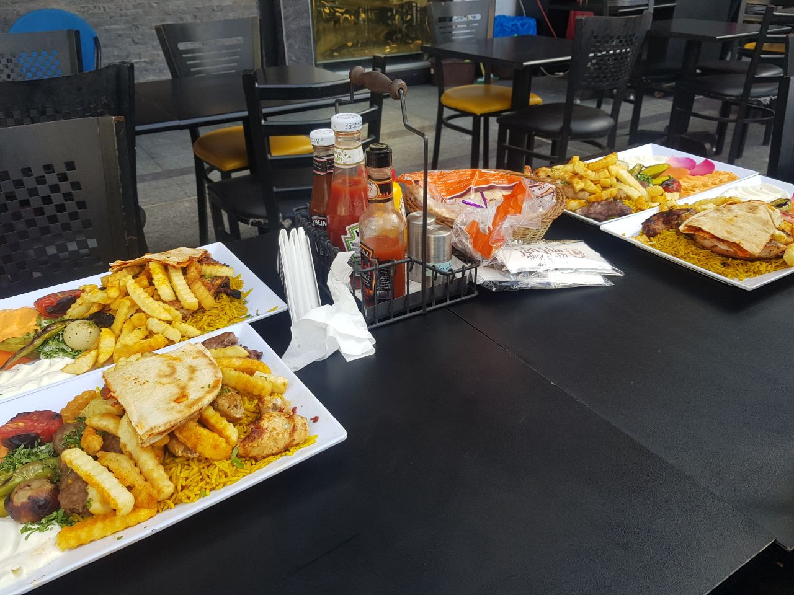
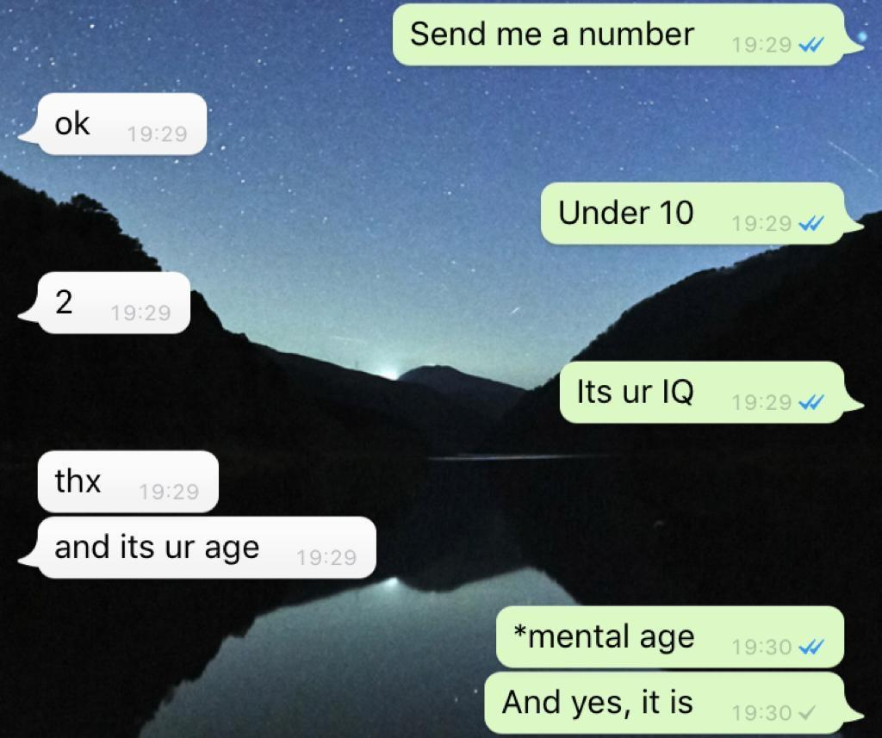
Problem?
Personal Images
(PIs)
Irrelevant Images
(IRIs)

Slide 3

Solution?
Personal Images Classifier
A and/or Method of Automating PIs & IRIs Classification
DL
ML

Slide 4
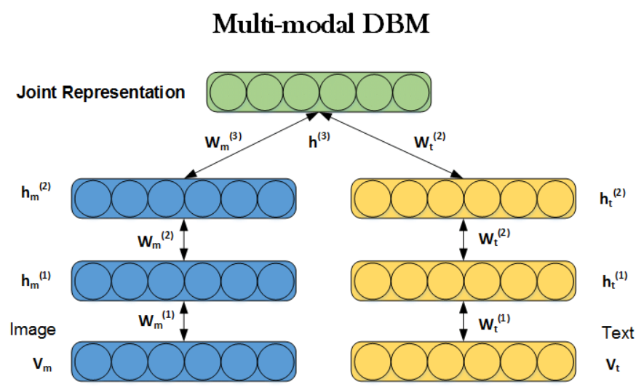

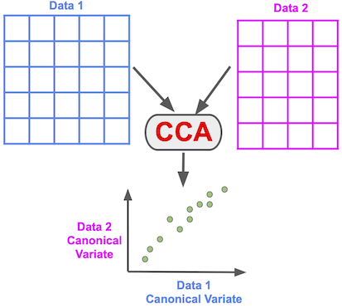
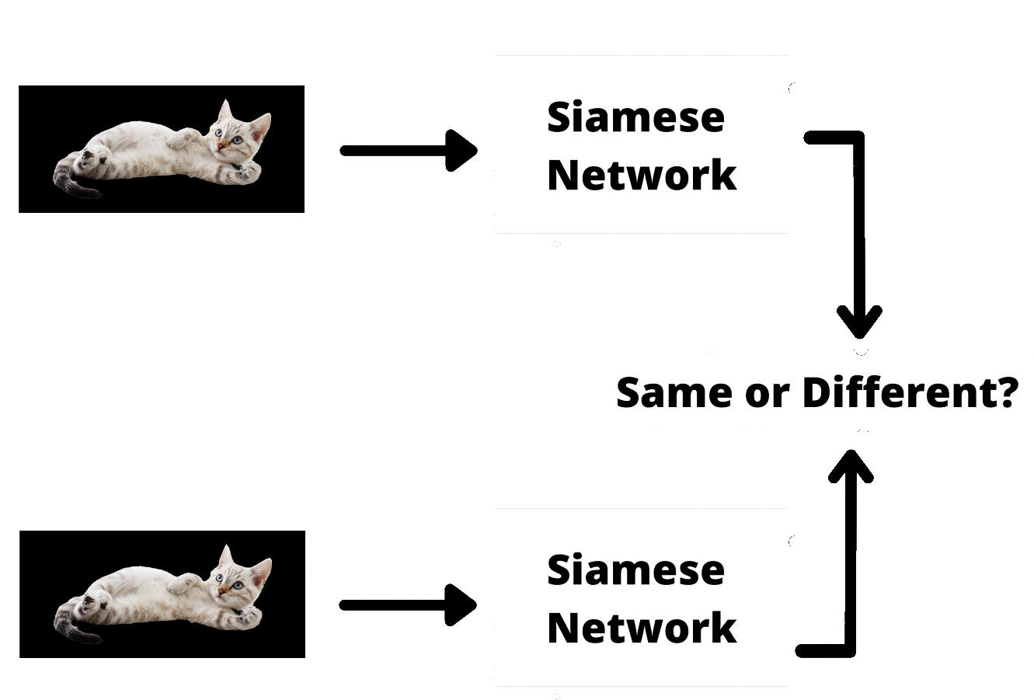
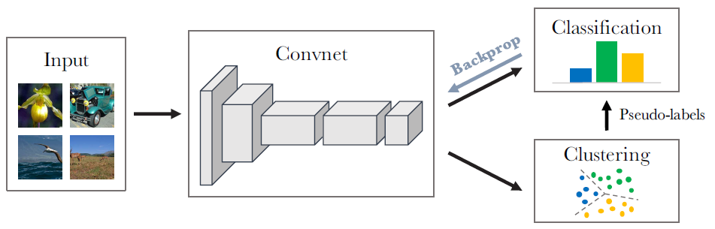
DL
ML
SVM
DeepCluster

Slide 5
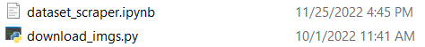

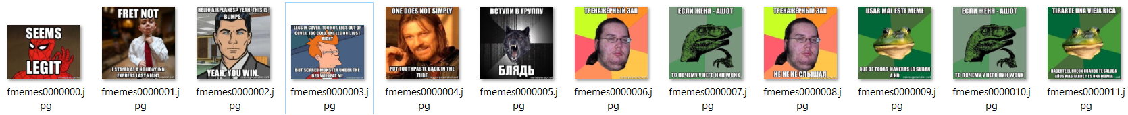
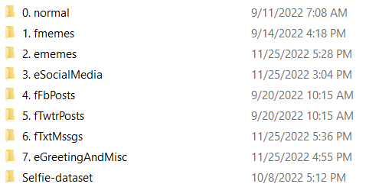
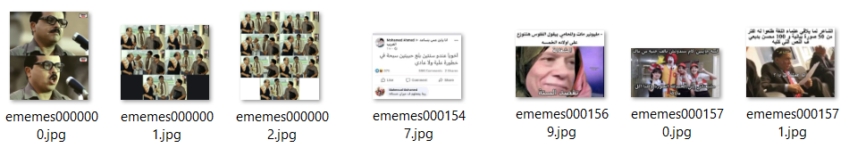

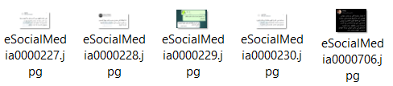
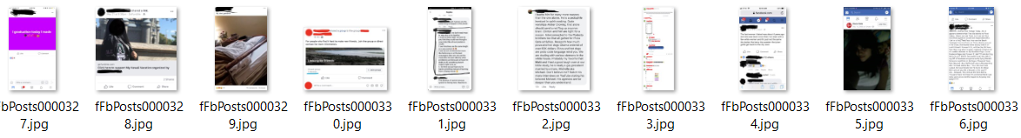
Work Done So Far?
Scraping
Examples
1.
32K
2.
16K
6.7K
2K
0.9K
3.
16K
17K
4.
46K

Slide 6
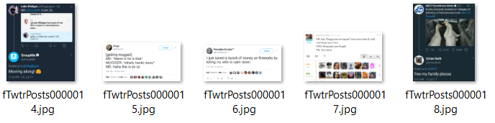
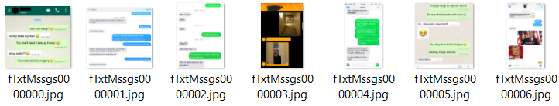
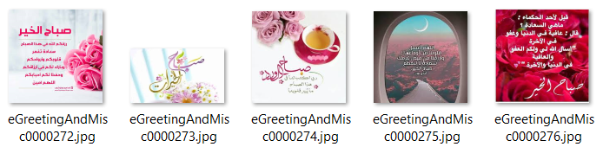
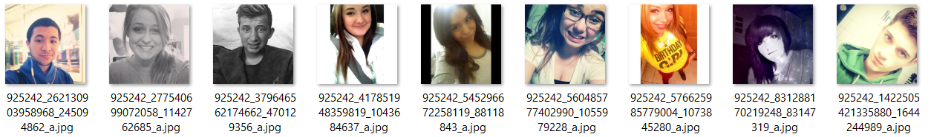
Work Done So Far?
Scraping
Examples
5.
32K
6.
16K
6.7K
2K
0.9K
16K
7.
17K
46K
*8*.

Slide 7
Possible Approach to Categorize Folders?
Clustering
!

Slide 8
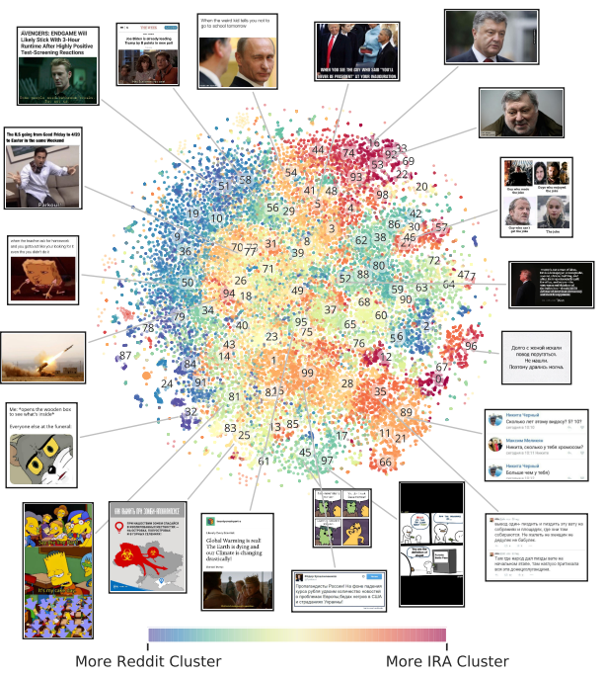
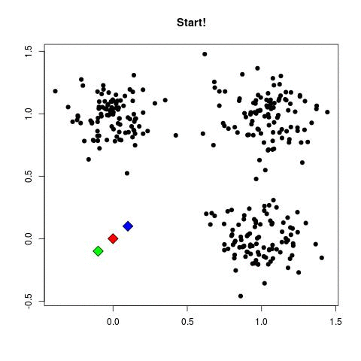
Possible Approach to Categorize Folders?
K-Means
Clustering

Slide 9
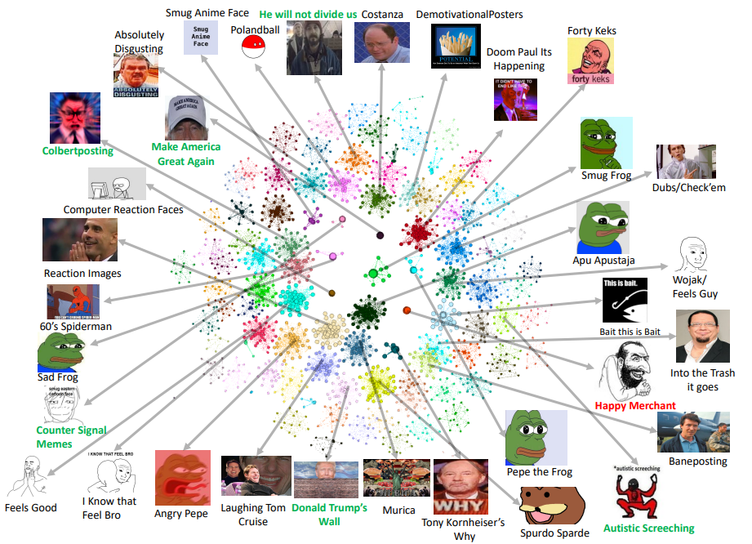
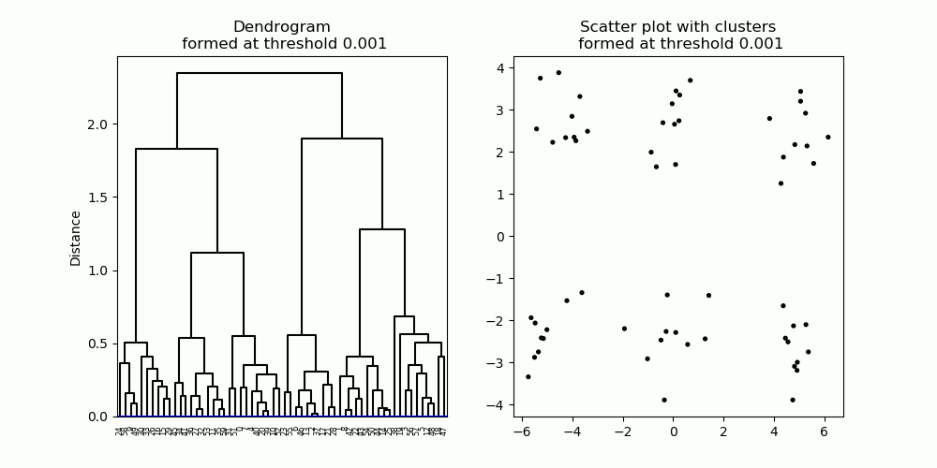
Possible Approach to Categorize Folders?
Hierarchical
Clustering

Slide 10
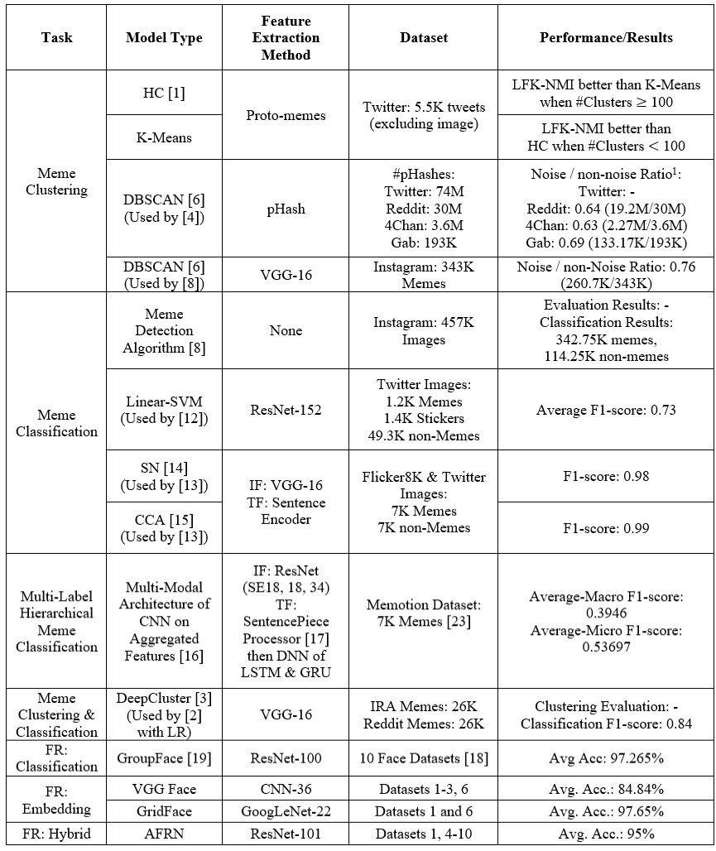
Summary of Related Models

Slide 11


